Slide 1

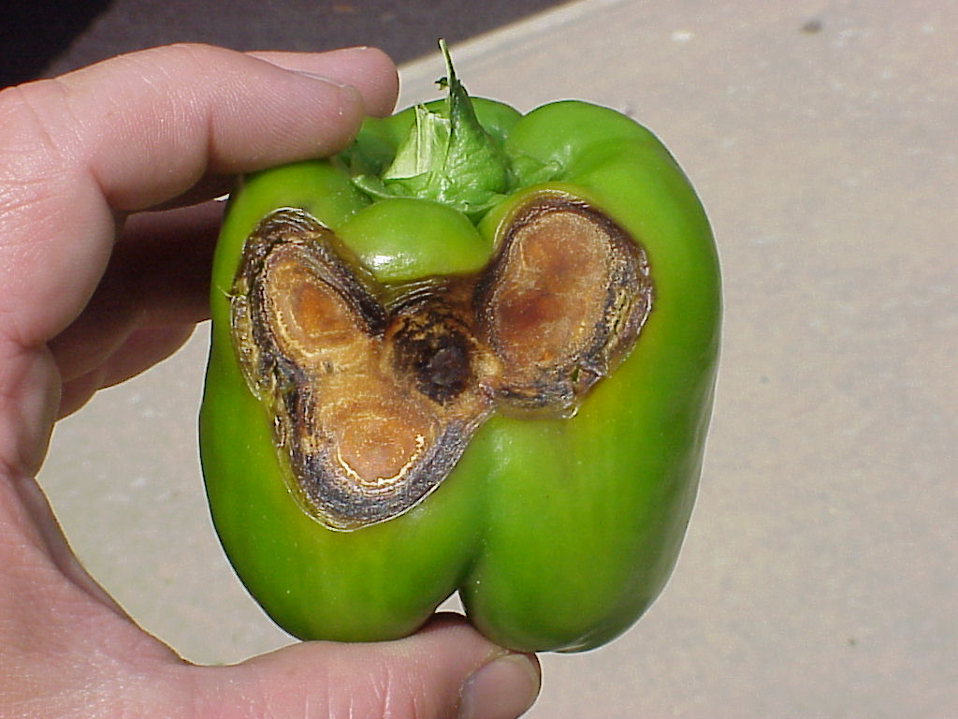
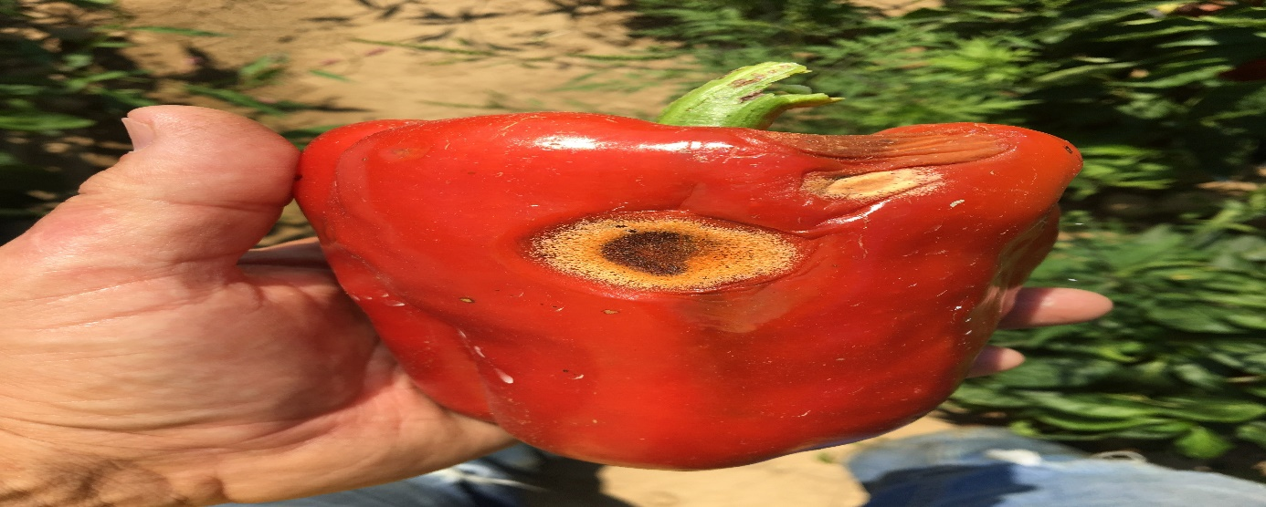
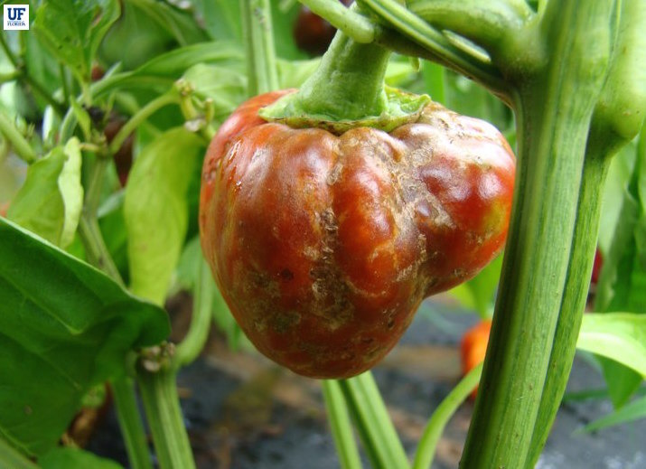
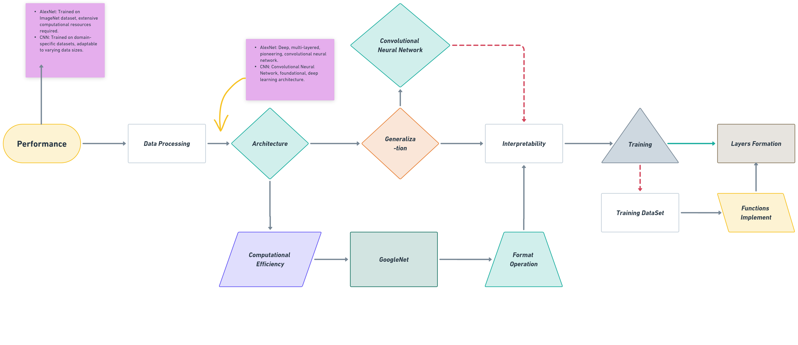

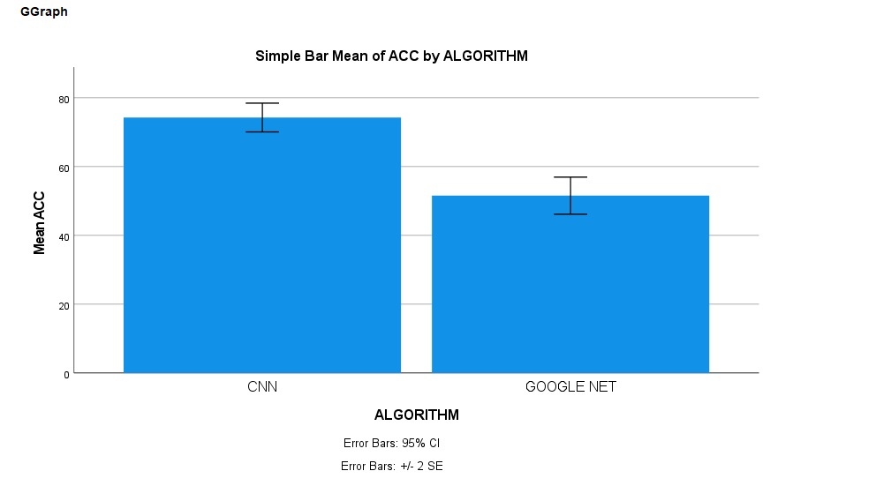
Name : Mr. Vigneshwaran P Register Number : 192124181
Guided by : Dr. C. Chandravathi
Ms. Poorani.S
Guided by Dr. Mary Valantina. G
Peppercheck: Deep Learning-based Bell Pepper Detection Disease using Convolutional Neural Network and GoogleNet,Formation for the Inception function through a method in Accuracy
INTRODUCTION
Bell peppers (Capsicum annuum) are versatile and widely cultivated vegetables, valued for their vibrant colors, distinct flavors, and nutritional benefits. However, like many crops, bell peppers are susceptible to various diseases and pests, which can significantly impact yield and quality.
In recent years, advances in computer vision and deep learning have opened up new possibilities for early and accurate detection of plant diseases. This study investigates the application of Convolutional Neural Networks (CNN) and GoogleNet (also known as Inception-v1) architectures for detecting diseases in bell peppers based on image analysis.
CNNs have demonstrated remarkable success in image recognition tasks, while GoogleNet, with its inception modules, offers a deeper and more complex architecture capable of capturing intricate features. By comparing these two models, we aim to assess their effectiveness in identifying common diseases affecting bell peppers and explore the potential for integrating advanced technology solutions into agricultural practices.
This research holds promise for enhancing disease management strategies, promoting sustainable farming practices, and safeguarding bell pepper production against disease threats.
Bell Pepper Detection Disease
MATERIALS AND METHODS
RESULTS
The comparison between GoogleNet and CNN (Convolutional Neural Network) for bell pepper disease detection reveals several key findings. GoogleNet, with its inception modules, showcases a deeper and more intricate architecture compared to traditional CNNs. In terms of performance, GoogleNet demonstrates impressive accuracy in identifying bell pepper diseases, leveraging its sophisticated feature extraction capabilities.
However, CNNs, being foundational in deep learning, also exhibit robust performance in disease detection tasks. The results highlight GoogleNet's efficiency in capturing intricate patterns and features within bell pepper images, contributing to its high accuracy.
The trade-off between GoogleNet's complexity and CNN's simplicity is evident, with both architectures showcasing strengths in different aspects of bell pepper disease detection. The computational efficiency of CNNs makes them more accessible for practical.
CNN and GoogleNet
Detecting bell peppers in images using Convolutional Neural Networks (CNN) and GoogleNet Algorithm involves training these models on a dataset monitoring performance on the validation set to prevent overfitting. Use evaluation metrics such as accuracy and precision disease management is crucial for sustaining bell pepper production and ensuring food security
DISCUSSION AND CONCLUSION
Based on T-test Statistical analysis, the significance value of p=0.001 (independent sample T - test p<0.05) is obtained and shows that there is a statistical significant difference between the Group 1 and Group 2.
Overall , the accuracy of the Convolutional Neural Networks (CNN) is 74.26% and it is better than the GoogleNet. Models undergo training on the training set, with adjustments made based on validation performance.
Convolutional Neural Networks (CNN) - 74.26%
GoogleNet Algorithm - 51.56 %
From the work, it is concluded that Convolutional Neural Networks (CNN) consistently demonstrate superior accuracy compared to GoogleNet in the detection of bell pepper, highlighting the robustness and effectiveness of CNN architectures for image recognition tasks in agricultural contexts. A decision is then made between CNN and GoogleNet architectures based on computational resources and performance requirements. The dataset is divided into training and validation sets, with potential augmentation techniques applied to increase variability.
BIBLIOGRAPHY
Krizhevsky, A., Sutskever, I., & Hinton, G. E. (2012). "ImageNet Classification with Deep Convolutional Neural Networks." In Advances in Neural Information Processing Systems (NIPS), Vol. 25, pp. 1097-1105. This seminal paper introduces the use of deep convolutional neural networks (CNNs) for image classification tasks, revolutionizing the field of computer vision.
Szegedy, C., et al. (2015). "Going Deeper with Convolutions." In Proceedings of the IEEE conference on computer vision and pattern recognition (CVPR), pp. 1-9. This paper presents the inception modules, a key innovation in deep convolutional neural network architectures, leading to the development of GoogleNet. By incorporating inception modules, GoogleNet achieves deeper networks with reduced computational complexity, enabling more efficient and accurate image classification..
Simonyan, K., & Zisserman, A. (2014). "Very Deep Convolutional Networks for Large-Scale Image Recognition." arXiv preprint arXiv:1409.1556. This seminal paper introduces the VGG (Visual Geometry Group) architecture, characterized by its simplicity and depth. The VGG network consists of multiple convolutional layers with small filter sizes, resulting in highly discriminative features and improved performance on large-scale image recognition tasks.
He, K., et al. (2016). "Deep Residual Learning for Image Recognition." In Proceedings of the IEEE conference on computer vision and pattern recognition (CVPR), pp. 770-778.

